Slide 1
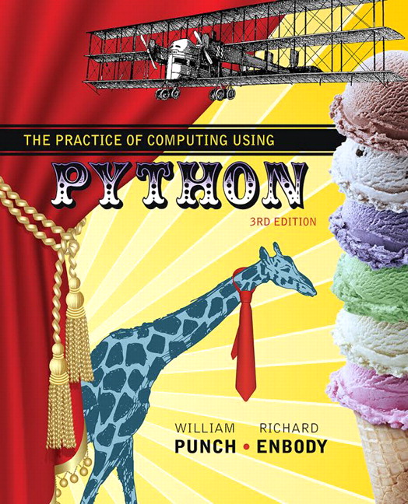
The Practice of Computing Using Python
Third Edition
Chapter 4
Working with Strings
Copyright © 2017, 2013, 2011 Pearson Education, Inc. All Rights Reserved
Notes:
If this PowerPoint presentation contains mathematical equations, you may need to check that your computer has the following installed:
1) MathType Plugin
2) Math Player (free versions available)
3) NVDA Reader (free versions available)

Slide 2
Sequence of Characters
We’ve talked about strings being a sequence of characters.
A string is indicated between
The exact sequence of characters is maintained

Slide 3
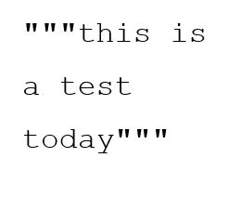
And then there is “““ ”””
Triple quotes preserve both the vertical and horizontal formatting of the string
Allows you to type tables, paragraphs, whatever and preserve the formatting

Slide 4
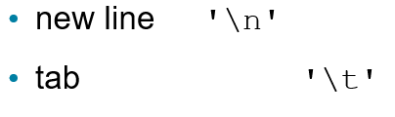
Non-printing Characters
If inserted directly, are preceded by a backslash (the \ character)

Slide 5
String Representation
Every character is “mapped” (associated) with an integer
U T F-8, subset of Unicode, is such a mapping
The function ord() takes a character and returns its U T F-8 integer value, chr() takes an integer and returns the U T F-8 character.

Slide 6
Subset of U T F-8 (1 of 2)
See Appendix F for the full set
Char | Dec | Char | Dec | Char | Dec
S P | 32 | @ | 64 | ` | 96
! | 33 | A | 65 | a | 97
" | 34 | B | 66 | b | 98
# | 35 | C | 67 | c | 99
$ | 36 | D | 68 | d | 100
% | 37 | E | 69 | e | 101
& | 38 | F | 70 | f | 102
' | 39 | G | 71 | g | 103
( | 40 | H | 72 | h | 104

Slide 7
Subset of U T F-8 (2 of 2)
Char | Dec | Char | Dec | Char | Dec
) | 41 | I | 73 | i | 105
* | 42 | J | 74 | j | 106
+ | 43 | K | 75 | k | 107
, | 44 | L | 76 | l | 108
- | 45 | M | 77 | m | 109
. | 46 | N | 78 | n | 110
/ | 47 | O | 79 | o | 111
0 | 48 | P | 80 | p | 112
1 | 49 | Q | 81 | q | 113
2 | 50 | R | 82 | r | 114
3 | 51 | S | 83 | s | 115
4 | 52 | T | 84 | t | 116

Slide 8
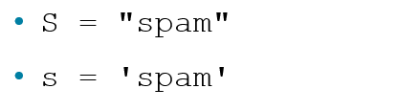
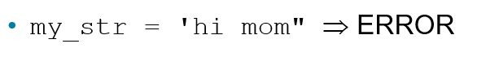
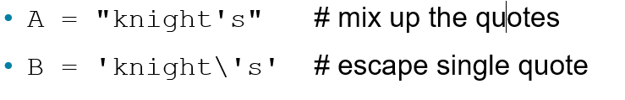
Strings
Can use single or double quotes:
Just don't mix them
Inserting an apostrophe:

Slide 9
The Index (1 of 2)
Because the elements of a string are a sequence, we can associate each element with an index, a location in the sequence:
positive values count up from the left, beginning with index 0
negative values count down from the right, starting with −1

Slide 10
The Index (2 of 2)
Figure 4.1 The index values for the string ‘Hello World’.

Slide 11
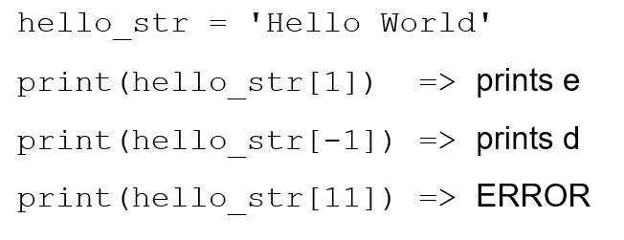
Accessing an Element
A particular element of the string is accessed by the index of the element surrounded by square brackets

Slide 12
Slicing, the Rules
Slicing is the ability to select a subsequence of the overall sequence
Uses the syntax [start : finish], where:
start is the index of where we start the subsequence
finish is the index of one after where we end the subsequence
If either start or finish are not provided, it defaults to the beginning of the sequence for start and the end of the sequence for finish

Slide 13
Half Open Range for Slices
Slicing uses what is called a half-open range
The first index is included in the sequence
The last index is one after what is included

Slide 14
Indexing and Slicing (1 of 4)
Figure 4.2 Indexing subsequences with slicing.

Slide 15
Indexing and Slicing (2 of 4)
Figure 4.3 Two default slice examples.

Slide 16
Indexing and Slicing (3 of 4)
Figure 4.4 Negative indices.

Slide 17
Indexing and Slicing (4 of 4)
Figure 4.5 Another slice example.

Slide 18
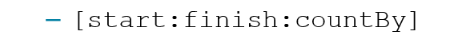
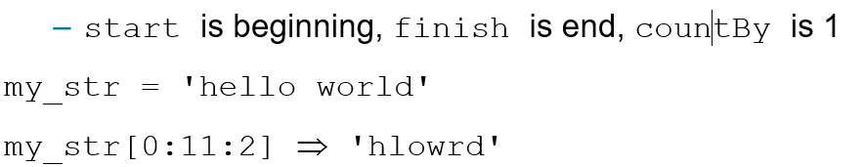
Extended Slicing (1 of 2)
Also takes three arguments:
Defaults are:
Every other letter

Slide 19
Extended Slicing (2 of 2)
Figure 4.6 Slicing with a step.

Slide 20
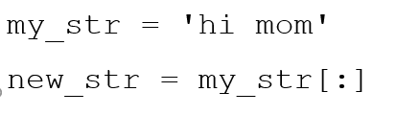
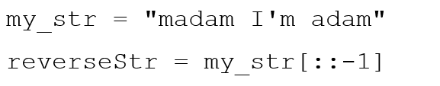
Some Python Idioms
Idioms are python “phrases” that are used for a common task that might be less obvious to non-python folk
How to make a copy of a string:
How to reverse a string

Slide 21
String Operations

Slide 22
Sequences are Iterable
The for loop iterates through each element of a sequence in order. For a string, this means character by character:

Slide 23
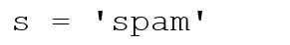
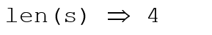
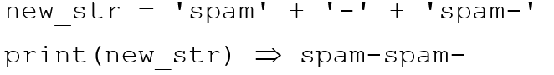
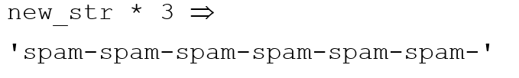
Basic String Operations
length operator len()
+ is concatenate
* is repeat, the number is how many times

Slide 24
Some Details
Both + and * on strings makes a new string, does not modify the arguments
Order of operation is important for concatenation, irrelevant for repetition
The types required are specific. For concatenation you need two strings, for repetition a string and an integer

Slide 25
What Does a + b Mean?
What operation does the above represent? It depends on the types!
Two strings, concatenation
Two integers addition
The operator + is overloaded.
The operation + performs depends on the types it is working on

Slide 26
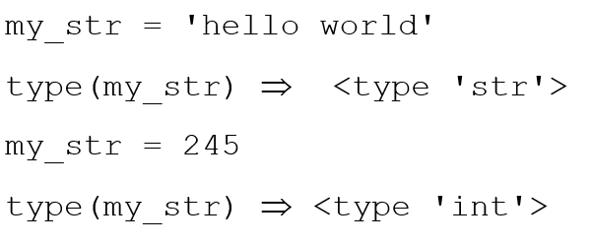
The type Function
You can check the type of the value associated with a variable using type

Slide 27
String Comparisons, Single char
Python 3 uses the Unicode mapping for characters.
Allows for representing non-English characters
U T F-8, subset of Unicode, takes the English letters, numbers and punctuation marks and maps them to an integer.
Single character comparisons are based on that number

Slide 28
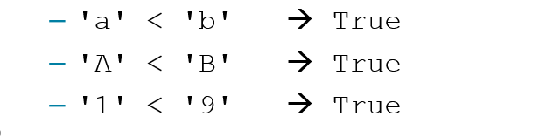
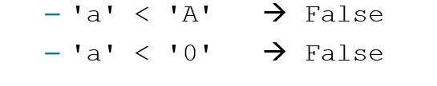
Comparisons within Sequence
It makes sense to compare within a sequence (lower case, upper case, digits).
Can be weird outside of the sequence

Slide 29
Whole strings
Compare the first element of each string
if they are equal, move on to the next character in each
if they are not equal, the relationship between those to characters are the relationship between the string
if one ends up being shorter (but equal), the shorter is smaller

Slide 30
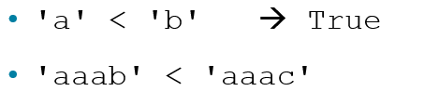
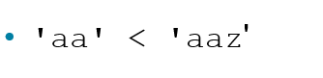
Examples
first difference is at the last char. 'b'<'c' so 'aaab' is less than 'aaac'. True
The first string is the same but shorter. Thus it is smaller. True

Slide 31
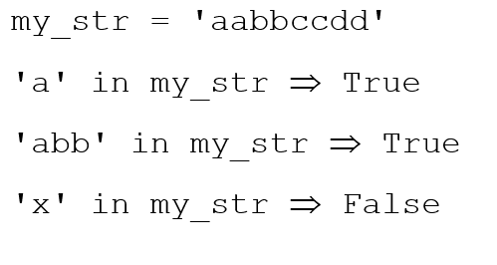
Membership Operations
Can check to see if a substring exists in the string, the in operator. Returns True or False

Slide 32
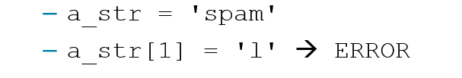
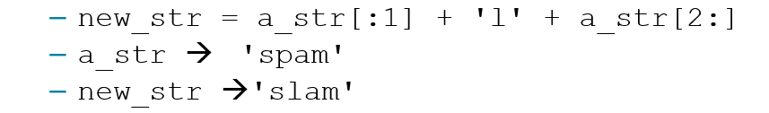
Strings are Immutable
strings are immutable, that is you cannot change one once you make it:
However, you can use it to make another string (copy it, slice it, etc.)

Slide 33
String Methods and Functions

Slide 34
Functions, First Cut
A function is a program that performs some operation. Its details are hidden (encapsulated), only it's interface provided.
A function takes some number of inputs (arguments) and returns a value based on the arguments and the function's operation.

Slide 35
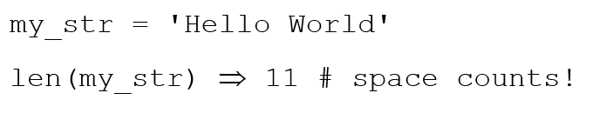
String Function : len
The len function takes as an argument a string and returns an integer, the length of a string.

Slide 36
String Method
a method is a variation on a function
like a function, it represents a program
like a function, it has input arguments and an output
Unlike a function, it is applied in the context of a particular object.
This is indicated by the dot notation invocation

Slide 37
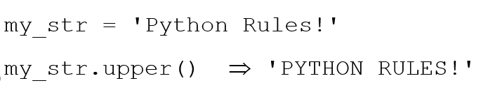
Example 1
upper is the name of a method. It generates a new string that has all upper case characters of the string it was called with.
The upper() method was called in the context of my_str, indicated by the dot between them.

Slide 38
More Dot Notation
In generation, dot notation looks like:
It means that the object in front of the dot is calling a method that is associated with that object's type.
The method's that can be called are tied to the type of the object calling it. Each type has different methods.

Slide 39
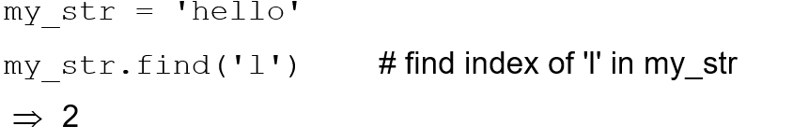
Find
Note how the method 'find' operates on the string object my_str and the two are associated by using the “dot” notation: my_str.find(‘l’).
Terminology: the thing(s) in parenthesis, i.e. the ‘l’ in this case, is called an argument.

Slide 40
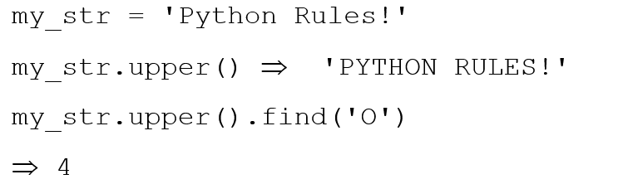
Chaining Methods
Methods can be chained together.
Perform first operation, yielding an object
Use the yielded object for the next method

Slide 41
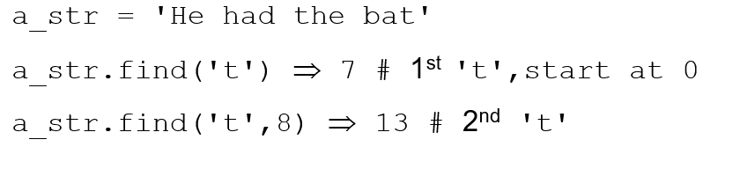
Optional Arguments
Some methods have optional arguments:
If the user doesn’t provide one of these, a default is assumed
Find has a default second argument of 0, where the search begins

Slide 42
Nesting Methods
You can “nest” methods, that is the result of one method as an argument to another
remember that parenthetical expressions are did “inside out”: do the inner parenthetical expression first, then the next, using the result as an argument
Translation: find the second ‘t’.

Slide 43
How to know? (1 of 4)
You can use Spyder to find available methods for any type. You enter a variable of the type, followed by the '.' (dot) and then a tab.
Remember, methods match with a type. Different types have different methods
If you type a method name, Spyder will remind you of the needed and optional arguments.

Slide 44
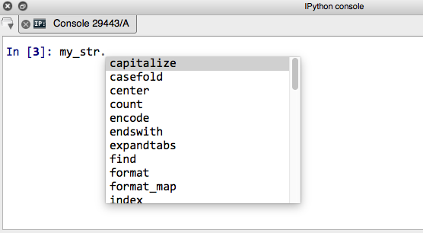
How to know? (2 of 4)
Figure 4.7 Tab lists potential methods.

Slide 45
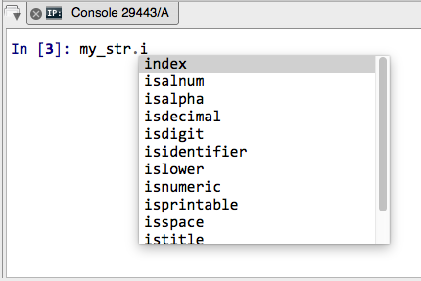
How to know? (3 of 4)
Figure 4.8 Tab lists potential methods, with leading letter.

Slide 46
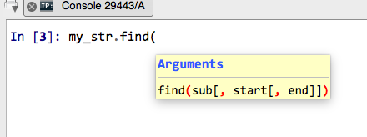
How to know? (4 of 4)
Figure 4.9 I D E pop-up provides help with function arguments.

Slide 47
Table 4.2 Python String Methods (1 of 2)
capitalize( ) | lstrip( [chars])
center( width[, fillchar]) | partition( sep)
count( sub[, start[, end]]) | replace( old, new[, count])
decode( [encoding[, errors]]) | rfind( sub [,start[,end]])
encode( [encoding[,errors]]) | rindex( sub[, start[, end]])
endswith( suffix[, start[, end]]) | rjust( width[, fillchar])
expandtabs( [tabsize]) | rpartition(sep)
find( sub[, start[, end]]) | rsplit( [sep [,maxsplit]])
index( sub[, start[, end]]) | rstrip( [chars])
isalnum( ) | split( [sep [,maxsplit]])
isalpha( ) | splitlines( [keepends])

Slide 48
Table 4.2 Python String Methods (2 of 2)
isdigit( ) | startswith( prefix[, start[, end]])
islower( ) | strip( [chars])
isspace( ) | swapcase( )
istitle( ) | title( )
isupper( ) | translate( table[, deletechars])
join(seq) | upper( )
lower( ) | zfill( width)
ljust( width[, fillchar]) | Blank

Slide 49
String formatting

Slide 50
String Formatting, Better Printing
So far, we have just used the defaults of the print function
We can do many more complicated things to make that output “prettier” and more pleasing.
We will use it in our display function

Slide 51
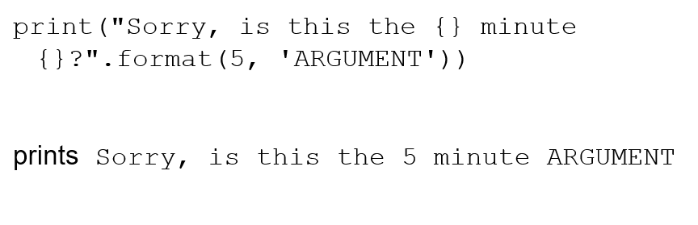
Basic Form
To understand string formatting, it is probably better to start with an example.

Slide 52
Format Method
format is a method that creates a new string where certain elements of the string are re-organized i.e., formatted
The elements to be re-organized are the curly bracket elements in the string.
Formatting is complicated, this is just some of the easy stuff (see the docs)

Slide 53
Map args to {}
The string is modified so that the {} elements in the string are replaced by the format method arguments
They replacement is in order: first {} is replaced by the first argument, second {} by the second argument and so forth.

Slide 54
Formatted Output for Strings
Figure 4.10 String formatting example.

Slide 55
Format String
the content of the curly bracket elements are the format string, descriptors of how to organize that particular substitution.
types are the kind of thing to substitute, numbers indicate total spaces.
Table 4.3 Most Commonly Used Types.
Table 4.4 Width Alignments.
s | String
d | decimal integer
f | floating-point decimal
e | floating-point exponential
% | floating-point as percent
< | left
> | right
˄ | center

Slide 56
Each Format String
Each bracket looks like
{:align width .precision descriptor}
align is optional (default left)
width is how many spaces (default just enough)
.precision is for floating point rounding (default no rounding)
type is the expected type (error if the arg is the wrong type)

Slide 57
Width and Alignment Descriptors
Figure 4.10 String formatting with width descriptors and alignment.

Slide 58
Nice Table

Slide 59
Floating Point Precision
Can round floating point to specific number of decimal places

Slide 60
Iteration

Slide 61
Iteration Through a Sequence
To date we have seen the while loop as a way to iterate over a suite (a group of python statements)
We briefly touched on the for statement for iteration, such as the elements of a list or a string

Slide 62
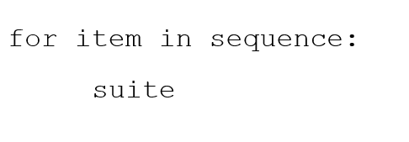
for Statement
We use the for statement to process each element of a list, one element at a time

Slide 63
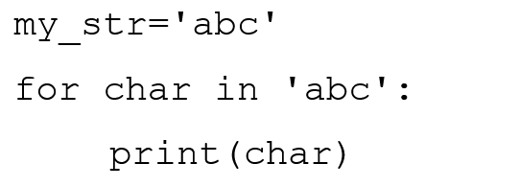
What for Means
first time through, char = 'a' (my_str[0])
second time through, char='b' (my_str[1])
third time through, char='c' (my_str[2])
no more sequence left, for ends

Slide 64
Power of the for statement
Sequence iteration as provided by the for state is very powerful and very useful in python.
Allows you to write some very “short” programs that do powerful things.

Slide 65
Code Listing 4.1 : Find a Letter

Slide 66
Enumerate function
The enumerate function prints out two values: the index of an element and the element itself
Can use it to iterate through both the index and element simultaneously, doing dual assignment

Slide 67
Code Listings 4.2 : Find with Enumerate

Slide 68
Split Function
The split function will take a string and break it into multiple new string parts depending on the argument character.
by default, if no argument is provided, split is on any whitespace character (tab, blank, etc.)
you can assign the pieces with multiple assignment if you know how many pieces are yielded.

Slide 69
Reorder a Name

Slide 70
Palindromes and the Rules
A palindrome is a string that prints the same forward and backwards
same implies that:
case does not matter
punctuation is ignored
"Madam I'm Adam" is thus a palindrome

Slide 71
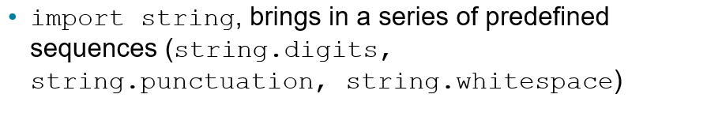
Lower Case and Punctuation
every letter is converted using the lower method
we remove all non-wanted characters with the replace method. First arg is what to replace, the second the replacement.

Slide 72
Code Listing 4.4 : Palindromes

Slide 73
More String Formatting

Slide 74
More String Formatting
We said a format string was of the following form:
Well, it can be more complicated than that
That's a lot, so let's look at the details

Slide 75
arg
To over-ride the {}-to-argument matching we have seen, you can indicate the argument you want in the bracket
if other descriptor stuff is needed, it goes behind the arg, separated by a :

Slide 76
fill, =
Besides alignment, you can fill empty spaces with a fill character:
0= fill with 0's
+= fill with +

Slide 77
Sign
+ means a sign for both positive and negative numbers
−means a sign for only negative numbers
space means space for positive, minus for negative

Slide 78
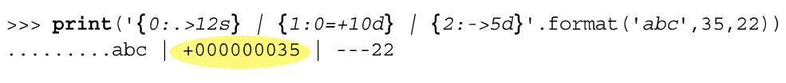
Example 2
args are before the :, format after
for example {1:0=10d} means:

Slide 79
# , and 0
# is complicated, but the simple version is that it forces a decimal point 0 forces fill of zero's (equivalent to 0=)
, put commas every three digits

Slide 80
Nice for Tables

Slide 81
Reminder, Rules so Far
Think before you program!
A program is a human-readable essay on problem solving that also happens to execute on a computer.
The best way to improve your programming and problem solving skills is to practice!
A foolish consistency is the hobgoblin of little minds
Test your code, often and thoroughly
If it was hard to write, it is probably hard to read. Add a comment.

Slide 82

Copyright

